Slide 1
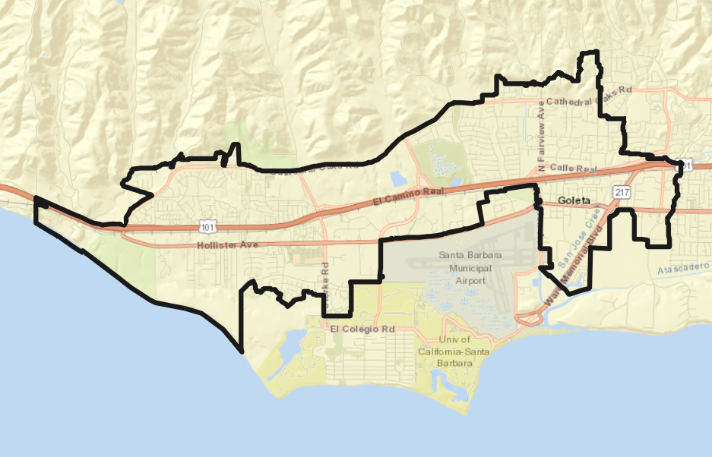
City of Goleta Transition to District Elections

Slide 2
Rules and Goals for Drawing Districts
1. Federal Laws
2. California Criteria for Cities
3. Other Traditional Districting Principles
Equal Population
Federal Voting Rights Act
No Racial Gerrymandering
Geographically contiguous
Undivided neighborhoods and “communities of interest” (Socio-economic geographic areas that should be kept together)
Easily identifiable boundaries
Compact (Do not bypass one group of people to get to a more distant group of people)
Prohibited:
“Shall not favor or discriminate against a political party.”
Respect voters’ choices / continuity in office
Future population growth

Slide 3
Neighborhood Maps

Slide 4
Noncontiguous Districts

Slide 5
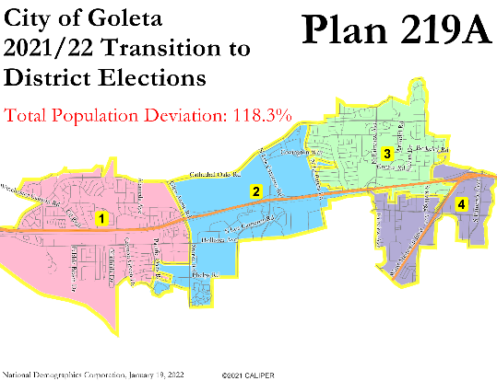
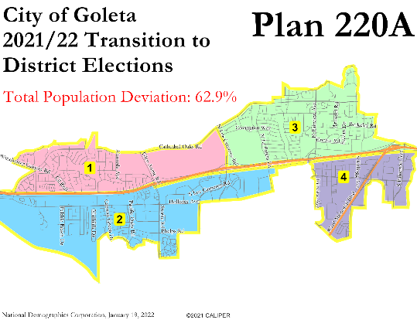
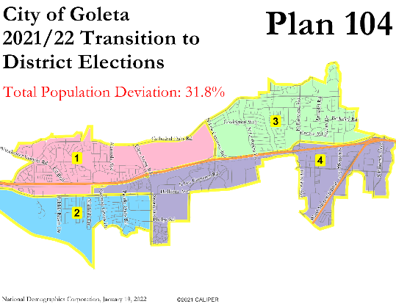
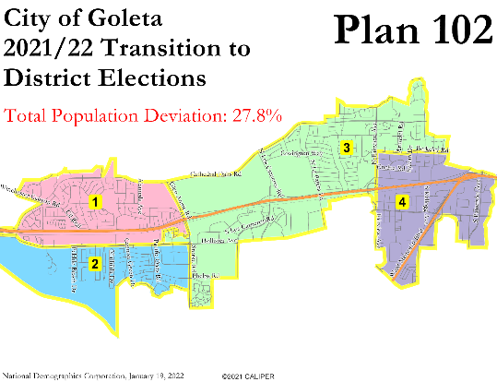
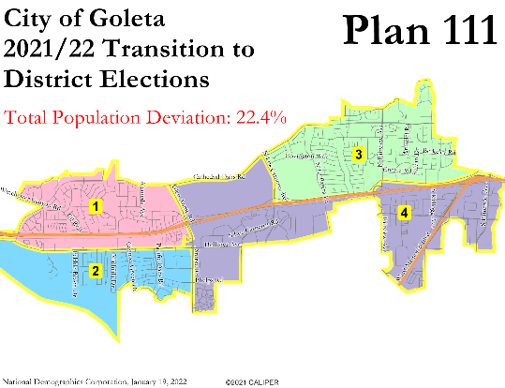
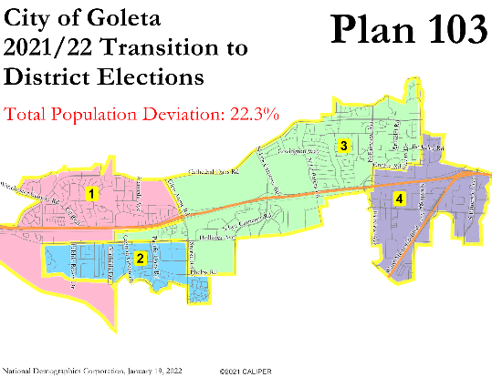
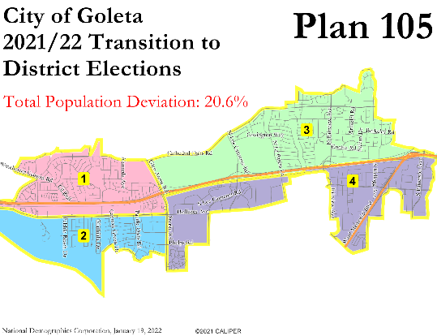
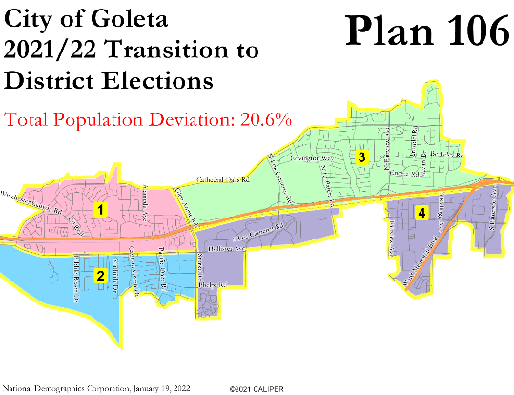
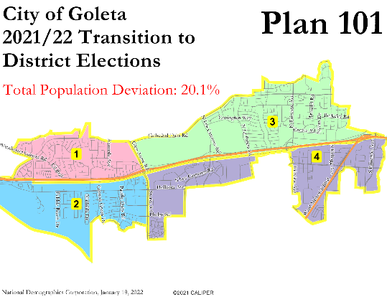
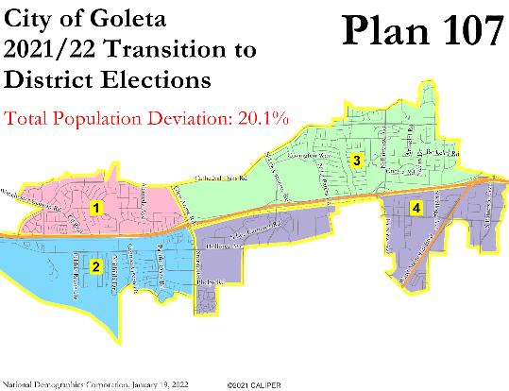
Unbalanced Districts

Slide 6
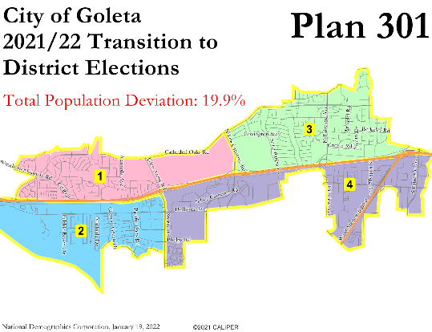
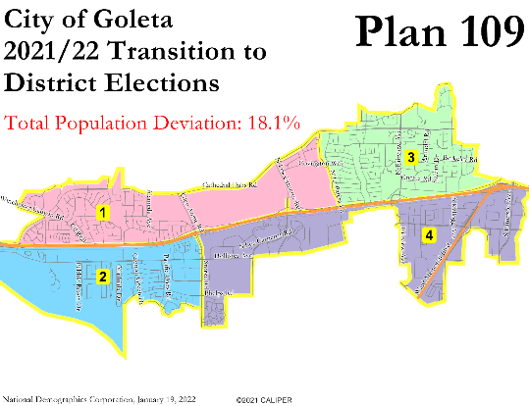
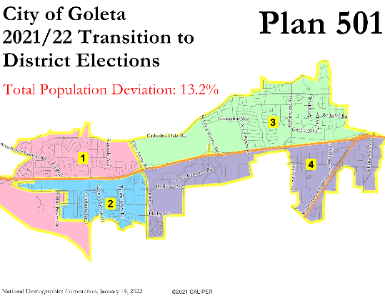
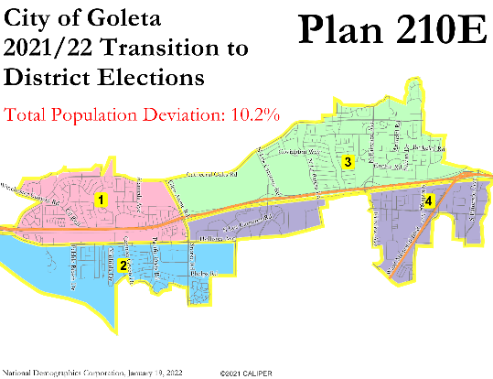
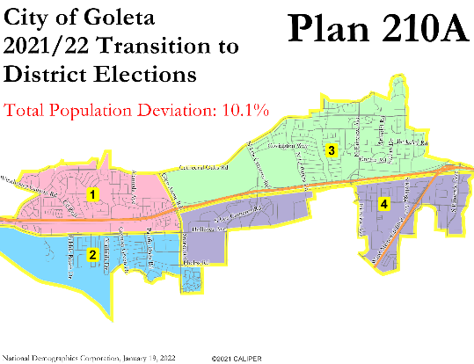
Unbalanced Districts

Slide 7
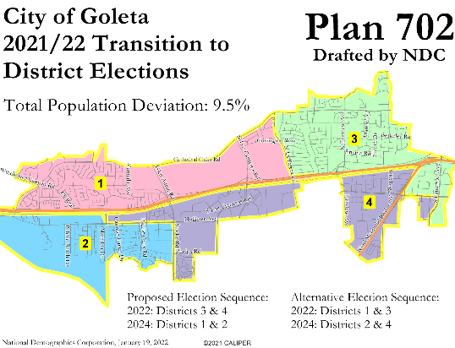
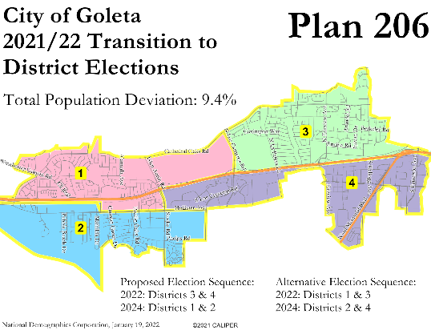
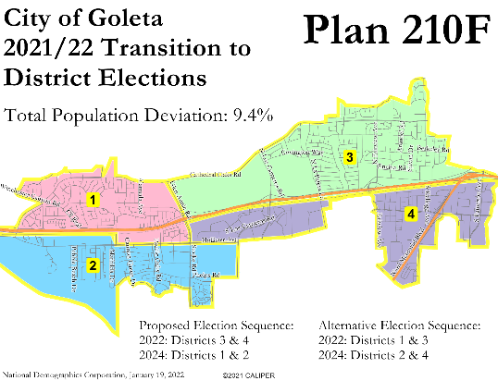
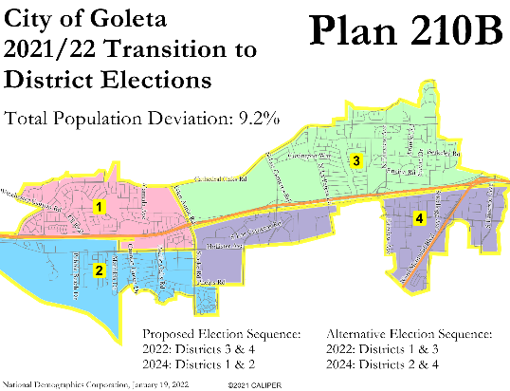
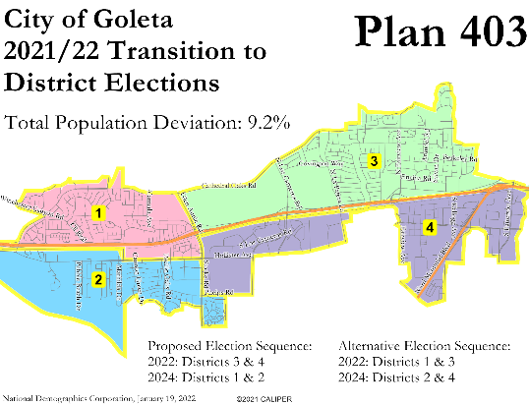
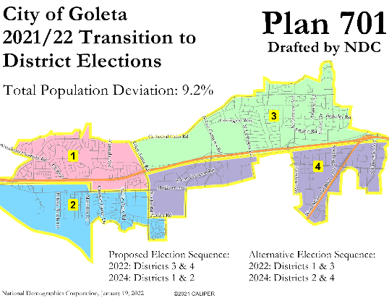
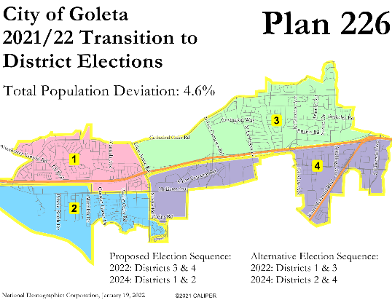
One District Crosses Minimally
Recommended
Recommended

Slide 8
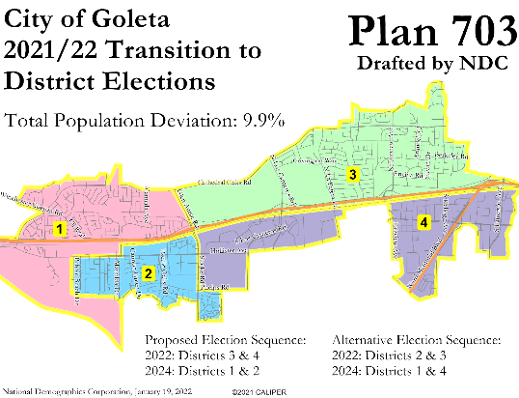
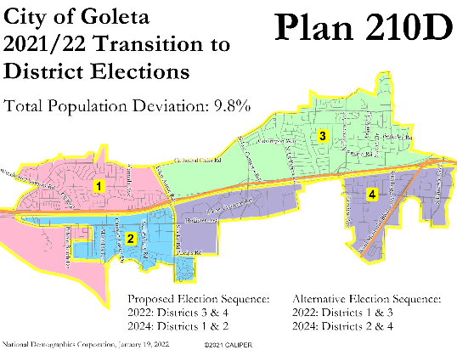
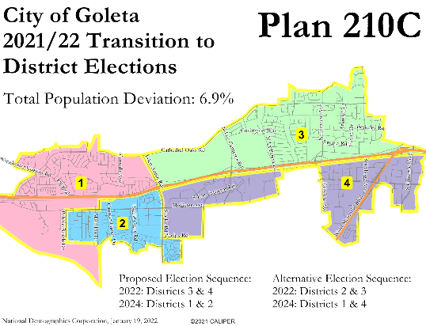
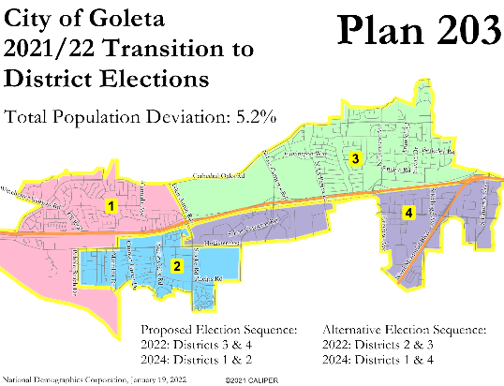
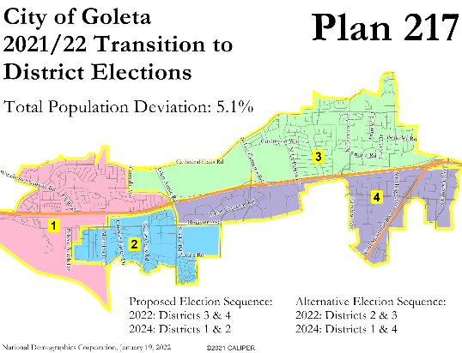
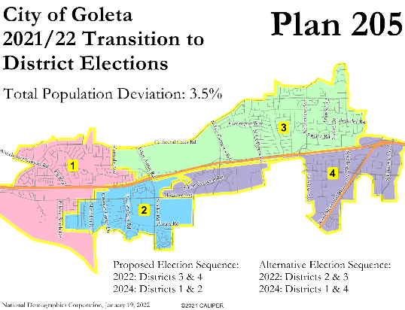
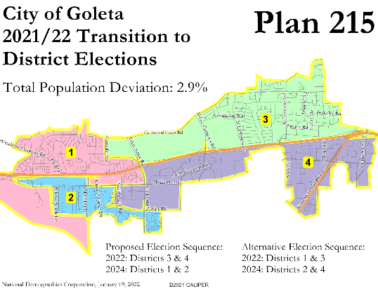
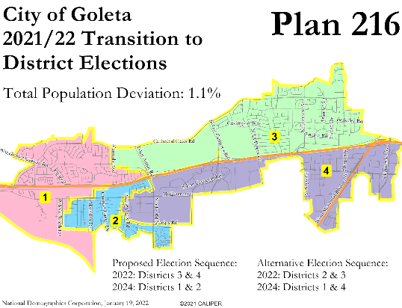
One District Crosses Substantially
Recommended

Slide 9
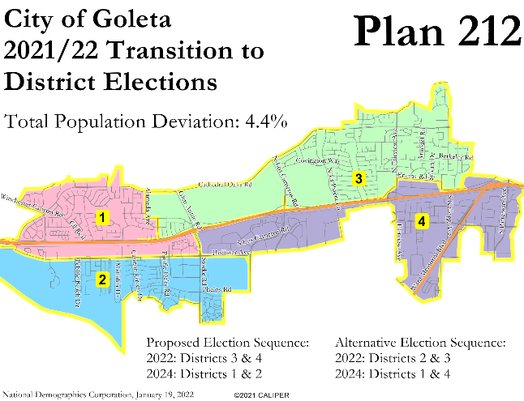
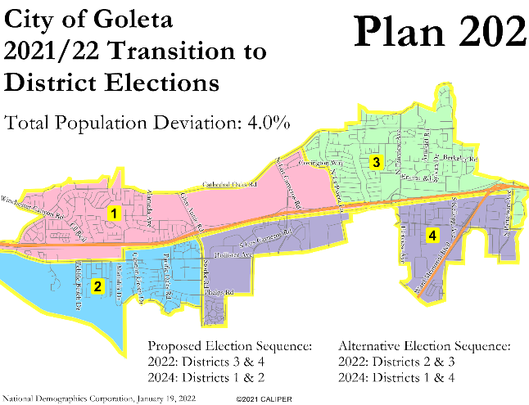
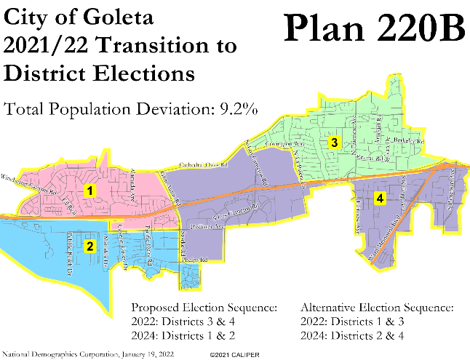
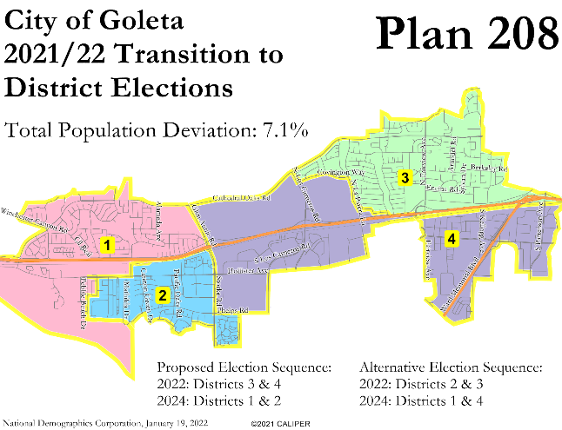
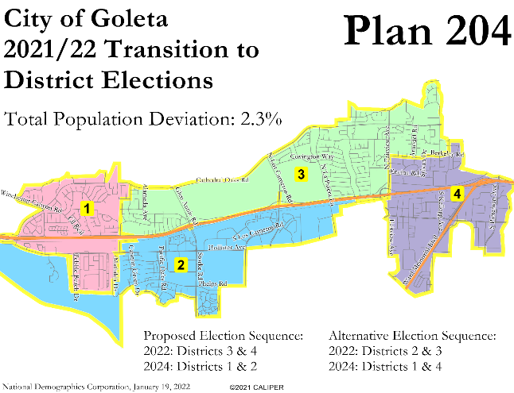
Two Districts Cross, Minimally or Substantially
Recommended

Slide 10
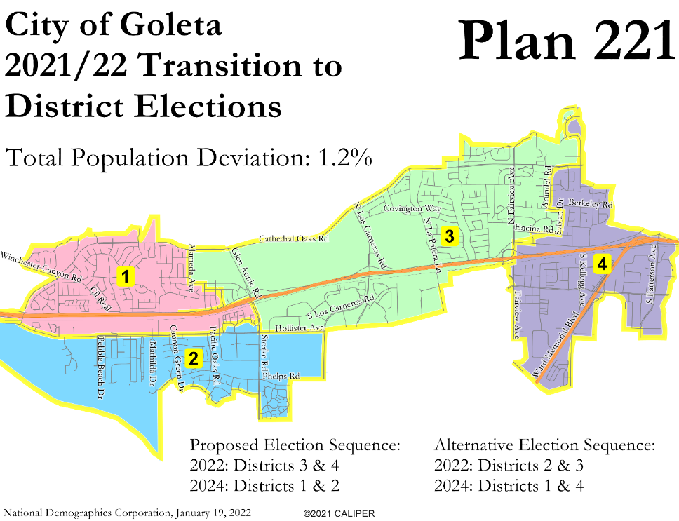
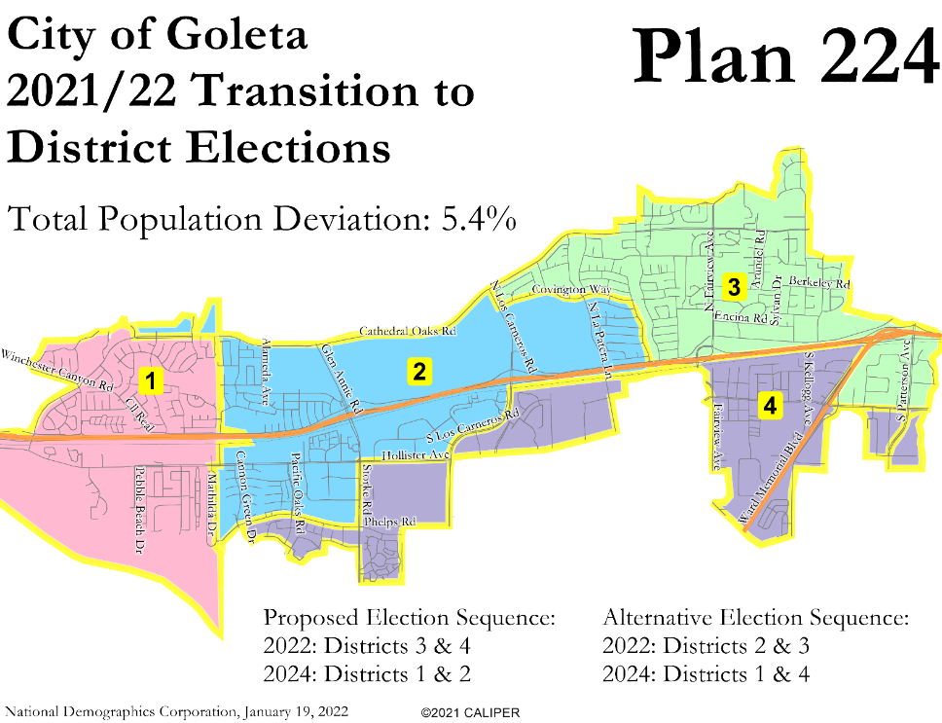
Three Districts Cross, Minimally or Substantially

Slide 11
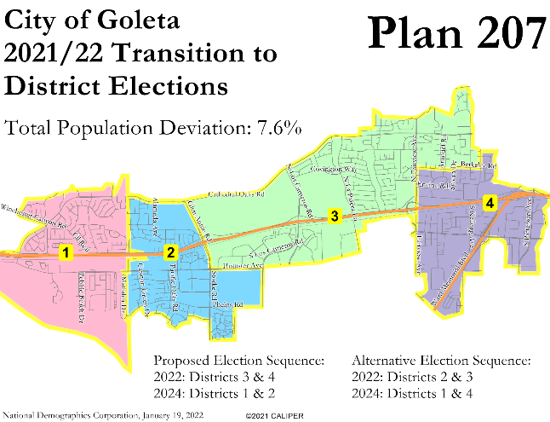
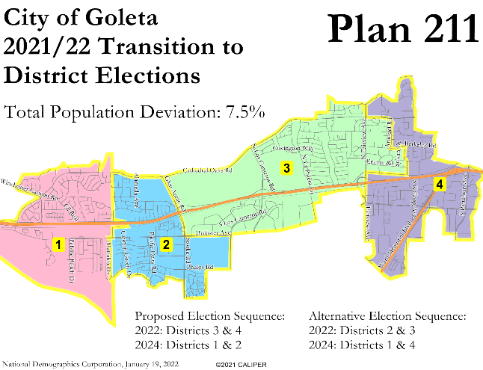
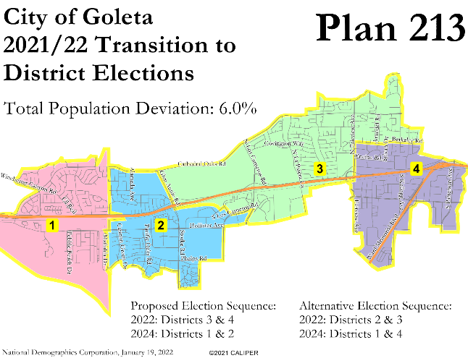
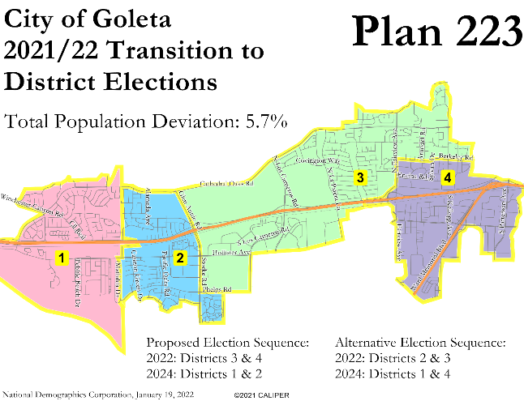
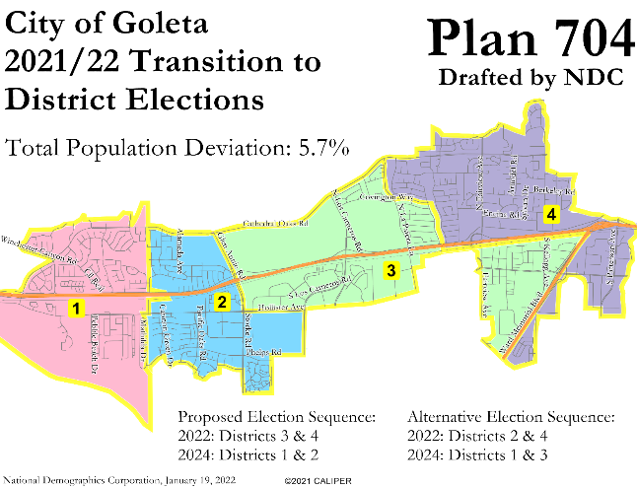
Four Districts Cross, District 3 Minimally

Slide 12
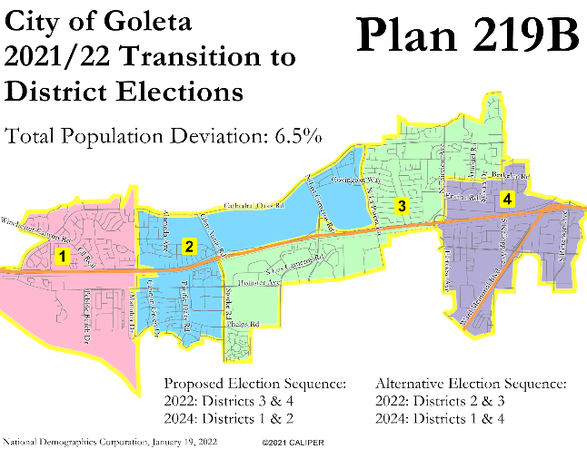
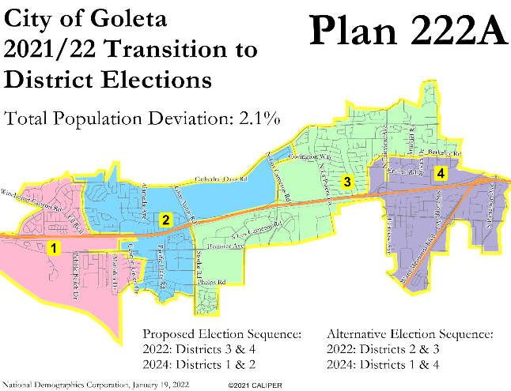
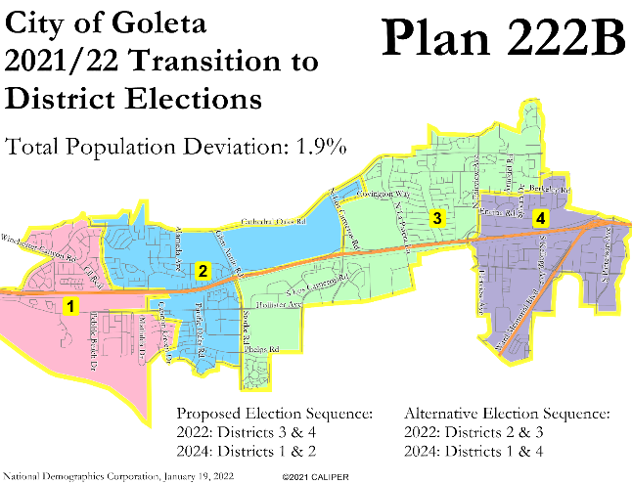
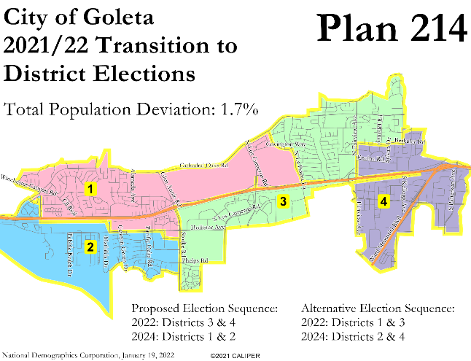
Four Districts Cross, District 3 Substantially

Slide 13
Focus Plans

Slide 14
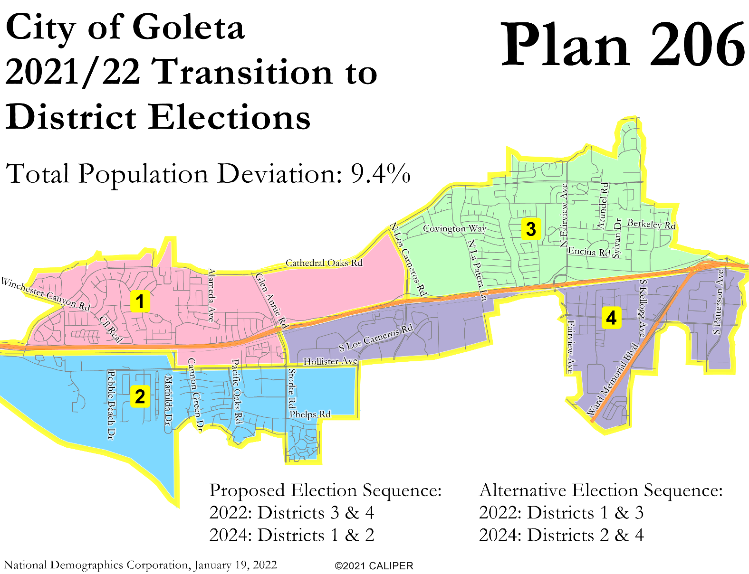
Focus Plans

Slide 15
Analysis of Focus Plans
Plan 701
District 1 crosses over minimally; all other districts stay on one side of the freeway
Population deviation: 9.2% (District 4 –2.8%)
District Latino CVAP: 29%, 25%, 15%, 32%
All four districts are contiguous
Does not split any neighborhoods
Closely adheres to general plan subareas as communities of interest and, to a lesser extent, elementary school attendance areas
Does not split the airport noise corridor or “demographic outliers”
District boundaries follow the railroad and major streets
All four districts are compact
Plan 206
District 1 crosses over minimally; all other districts stay on one side of the freeway
Population deviation: 9.4% (District 4 –2.9%)
District Latino CVAP: 29%, 25%, 15%, 32%
All four districts are contiguous
Does not split any neighborhoods
Closely adheres to general plan subareas as communities of interest and, to a lesser extent, elementary school attendance areas
Does not split the airport noise corridor or “demographic outliers”
District boundaries follow the freeway and major streets
All four districts are compact

Slide 16
Public Hearing & Discussion
Questions about the proposed districting plans?
Which plan(s) do you prefer?
What, if anything, would you like to see revised in your preferred plan(s)?
Please refer to the Interactive Review Map for a detailed look at each plan

