Slide 1
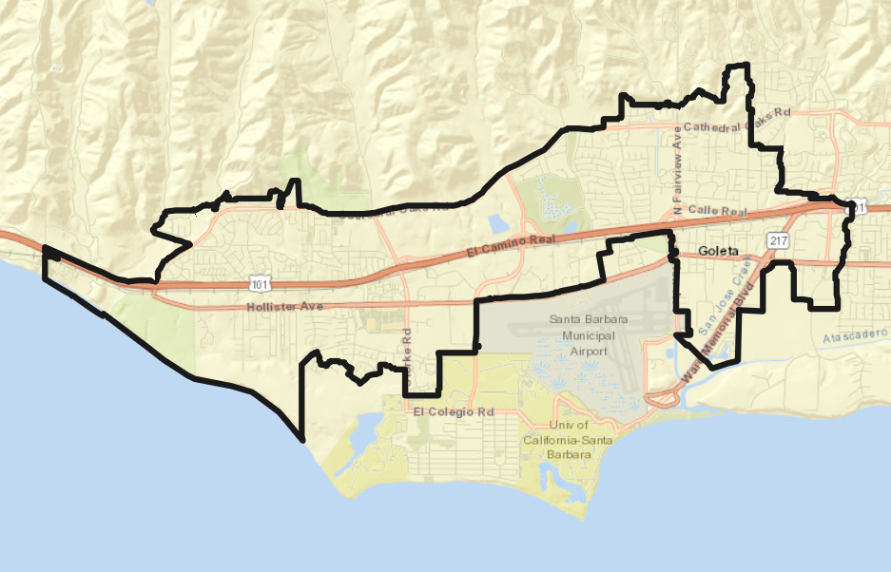
City of Goleta Introduction to Districting

Slide 2
Election Systems
“At Large”
“From District” or “Residence” Districts
“By District”
The California Voting Rights Act was written to specifically encourage by-district elections.

Slide 3
Districting Process
Step | Description
Public Workshops: June 7, June 26 & August 2 | Education and to solicit input on the communities in the City. First workshop virtual, second and third in person. Third workshop also serves as Pre-Draft Hearing #1.
Initial Pre-Draft Hearings: August 2 & 17 | Two meetings held prior to release of draft maps. Identify “neighborhoods,” “communities of interest,” and “secondary areas.” Second hearing will take place during regular City Council meeting.
Initial deadline for submitting draft maps January 14 | Deadline for the public to submit draft maps for inclusion in the next hearing packet and presentation
Release draft maps January 25 | Initial draft maps posted to project website
Two hearings on draft maps: February 1 & 15 | Two meetings to discuss and revise the draft maps and to discuss the election sequence. Will take place during regular City Council meetings.
Map adoption: March 1 | Map adopted via ordinance at regular City Council meeting. Final map must be posted at least 7 days prior to adoption.

Slide 4
Districting Rules and Goals
1. Federal Laws
2. California Criteria for Cities
3. Other Traditional Districting Principles
Equal Population
Federal Voting Rights Act
No Racial Gerrymandering
Geographically contiguous
Undivided neighborhoods and “communities of interest” (Socio-economic geographic areas that should be kept together)
Easily identifiable boundaries
Compact (Do not bypass one group of people to get to a more distant group of people)
Prohibited:
“Shall not favor or discriminate against a political party.”
Respect voters’ choices / continuity in office
Future population growth

Slide 5
Demographic Summary
Estimates from the American Community Survey (2015-2019).
Each of the 4 districts must contain about 7,500 people.

Slide 6
Defining Neighborhoods
1st Question: What is your neighborhood?
2nd Question: What are its geographic boundaries?
Examples of physical features defining a neighborhood boundary:
Natural neighborhood dividing lines, such as highway or major roads, rivers, canals and/or hills
Areas around parks or schools
Other neighborhood landmarks
In the absence of public testimony, planning records and other similar documents may provide definition.

Slide 7
Beyond Neighborhoods: Defining Communities of Interest
1st Question: What defines your community of interest?
Geographic Area, plus
Shared issue or characteristic
Shared social or economic interest
Impacted by city policies
Tell us “your community’s story”
2nd Question:
Would this community of interest benefit from being “included within a single district for purposes of its effective and fair representation”?
Or would it benefit more from having multiple representatives?
Definitions of Communities of Interest may not include relationships with political parties, incumbents, or political candidates.

Slide 8
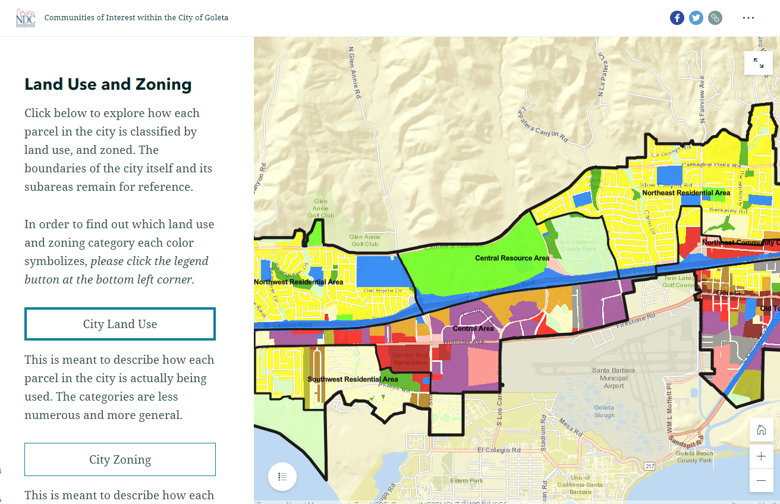
Possible Neighborhoods / Communities
Explore using NDC’s “Story Map” of Goleta
Similar to PowerPoint, but interactive
Used to identify potential “communities of interest”
Goleta’s Story Map

Slide 9
Public Mapping and Map Review Tools
Different tools for different purposes
Different tools for different levels of comfort and interest
Simple “learn about your community” map
Simple “review draft maps” tool
Easy-to-use “Draw your neighborhood” tool
Paper- and Excel-based simple “Draw a draft map” tools
Powerful, data-rich “Draw a draft map” tool
Whether you use the powerful (but complicated) online mapping tool, Excel, the paper kit, or just draw on a napkin, we welcome your maps!

Slide 10
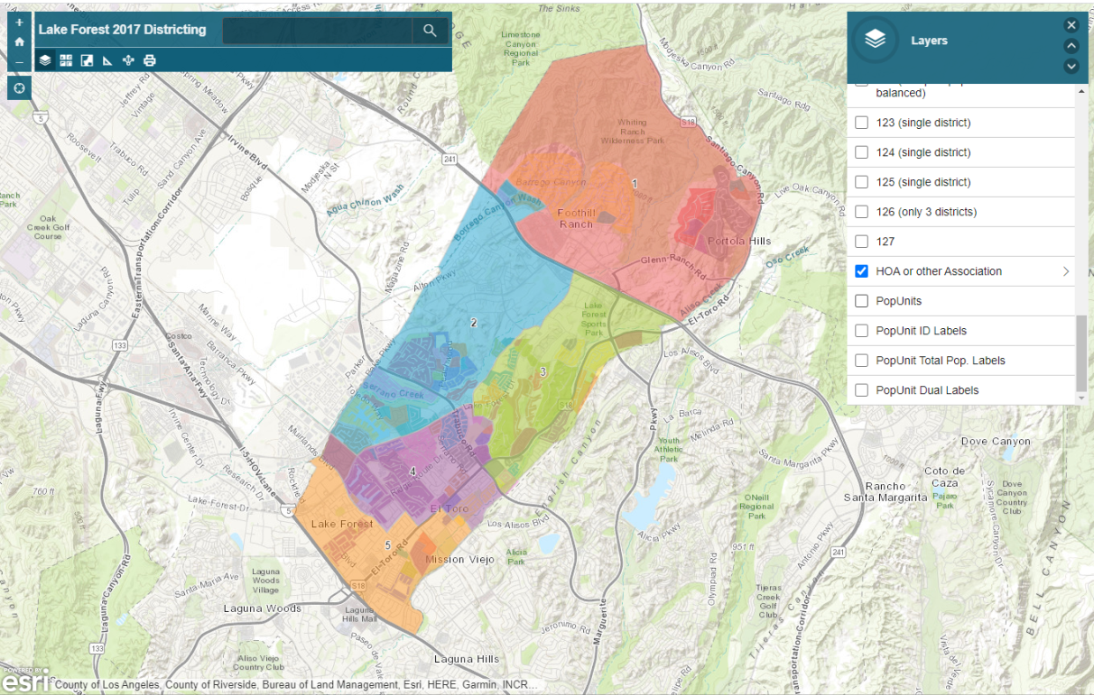
Simple Map Review Tool
Online Interactive Review Map
ESRI’s “ArcGIS Online” – similar to Google Maps in ease of use
Used to review, analyze and compare maps, not to create them
Includes overlays of “community of interest” and other Story Map data
Sample map from Lake Forest

Slide 11
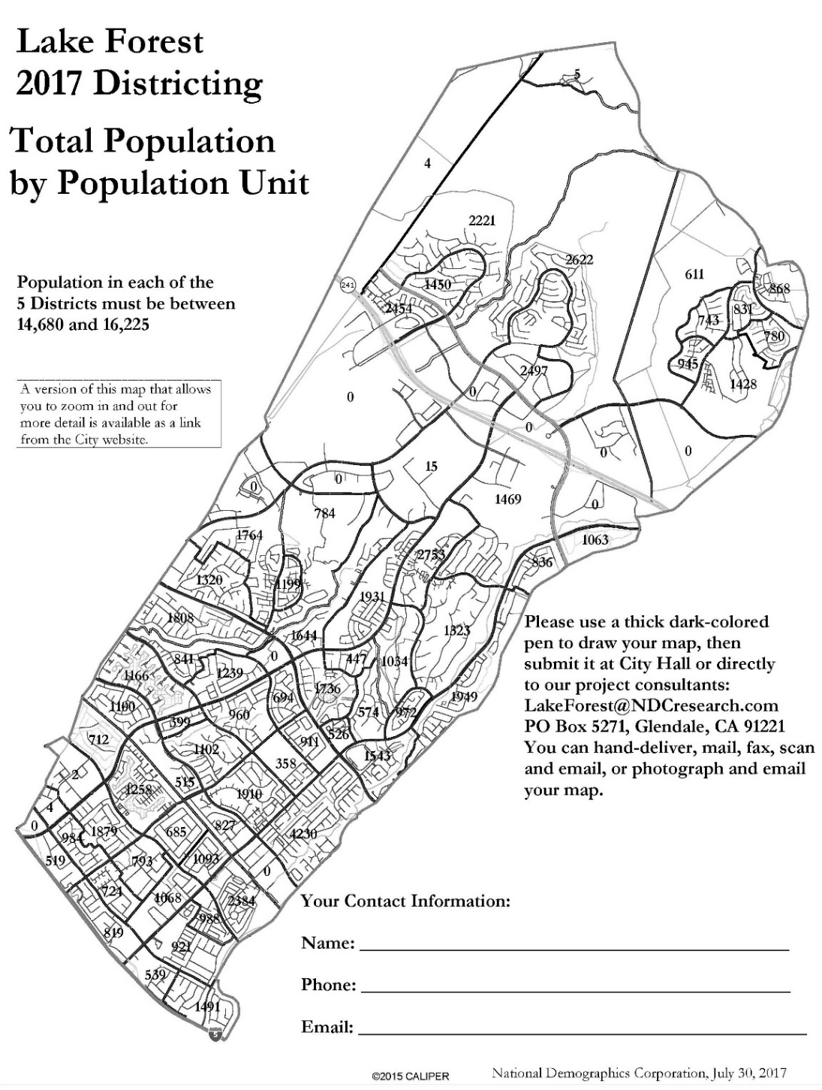
Simple Map Drawing Tool
Paper “Public Participation Kit”
For those without internet access or who prefer paper
Total Population Counts only – no demographic numbers
Geographic units would be small neighborhood segments as exemplified by this map

Slide 12
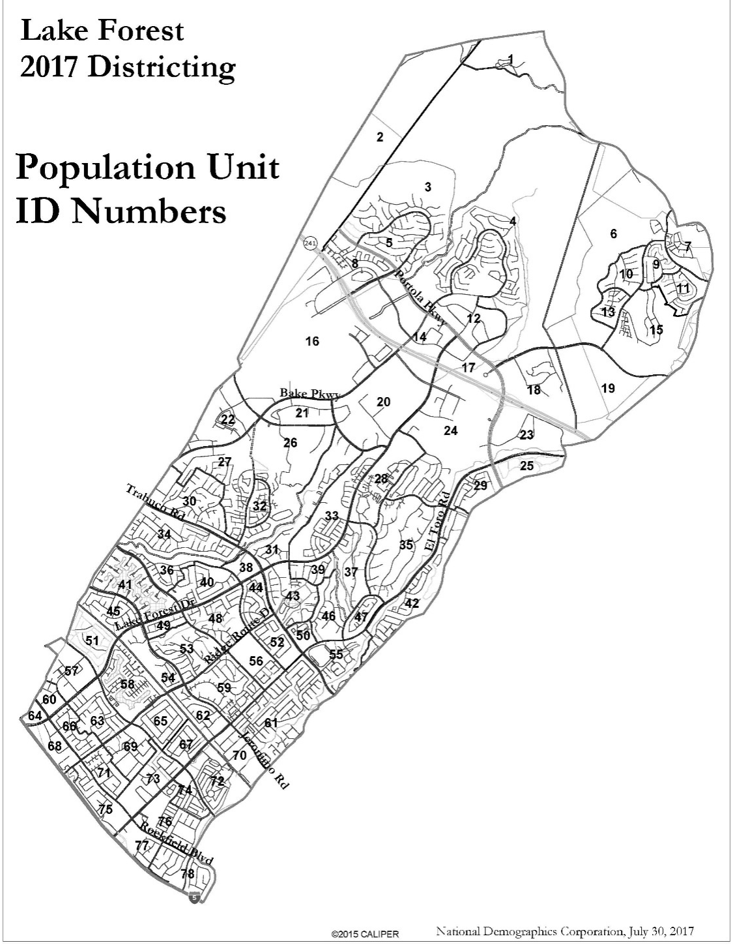
Simple Map Drawing Tool + Excel Supplement
“Public Participation Kit”
For those who know Excel and do not wish to use online tools
Adds CVAP data
Excel does the math
Geographic units would be small neighborhood segments as exemplified by this map

Slide 13
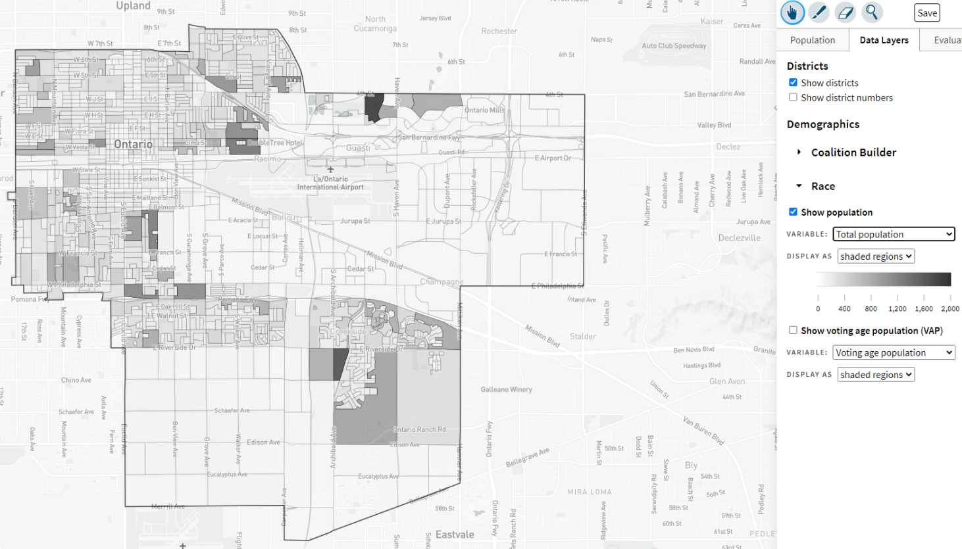
DistrictR
“Draw Your Community of Interest” focus
Also includes simple district-mapping tool
Only available in English

Slide 14
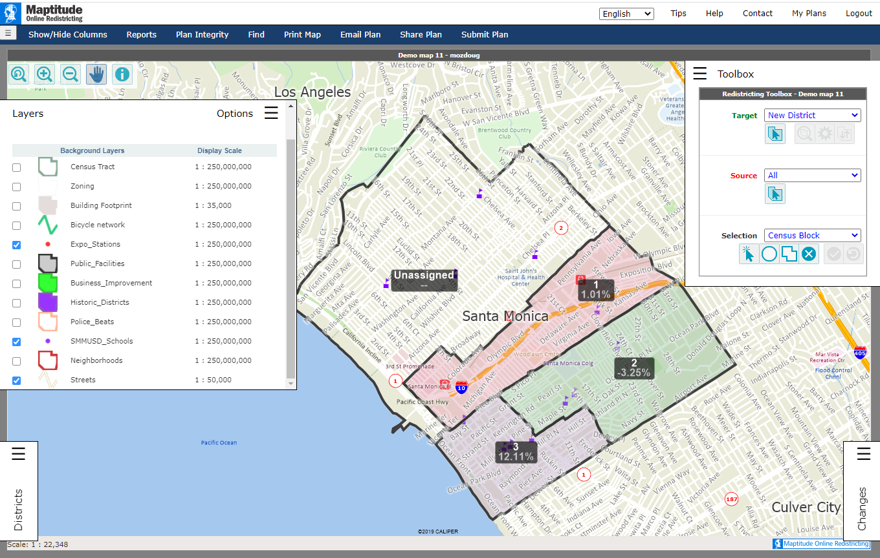
Caliper’s “Maptitude Online Redistricting”
Full Database, Powerful Online Mapping Tool
Powerful, common, data-rich online tool
Six language options: English, Spanish, Portuguese, Vietnamese, Mandarin and Korean
Quick Start Guide

Slide 15
Public Hearing & Discussion
What is your neighborhood and what are its boundaries?
What other notable areas are in the city, and what are their boundaries?
Any questions about the mapping tools?
Please visit the website for more information: drawgoleta.org

